Slide 1
Integration of Statistical and Spatial Information for Data Dissemination in Cape Verde
United Nations Regional Workshop on Data Dissemination and Communication
Amman, Jordan – 9 to 12 September 2013
Amândio Furtado
Amandio.furtado@ine.gov.cv

Slide 2
Summary
About Cape Verde
The National Statistical System (NSS) and National Institute of Statistics (NIS)
Data Dissemination in the NIS
Some Dissemination Products (an overview)
The WebGIS-INE (A Geospatial Tool to Disseminate Data Trough Internet)
An Example of integrating Statistical and Spatial Data

Slide 3
About Cape Verde
Atlantic Ocean

Slide 4
About Cape Verde
Atlantic Ocean
West Cost of Africa (Western Country of Africa)
500 Km from Senegal

Slide 5
About Cape Verde
Atlantic Ocean
West Cost of Africa (Western Country of Africa)
500 Km from Senegal
10 Islands of Volcanic Origins
Area: 4.033 Km²
Population: 491.683 (2010)
512173 (Est. -2013)
Capital: Praia
Independence: July 1975
Praia

Slide 6
About Cape Verde
10 - Island
Political-Administrative divisions

Slide 7
About Cape Verde
22 - Municipalities
Political-Administrative divisions

Slide 8
About Cape Verde
32 - Freguesias
Political-Administrative divisions

Slide 9
The NSS and NIS
CNEST
NIS and Central Bank
Delegates of INE - ODINE
State agency that oversees and coordinates superiorly the National Statistical System.
unifying body of producers and users of statistical information
Fixed guidelines for statistics, by outlining the national statistical activities and programs.
Holds the methodological coordination.
Approving the concepts, definitions, classifications and other instruments of technical coordination.
National statistical System

Slide 10
The NSS and NIS
CNEST (National Statistics Council)
NIS
Central Bank
Ministries – ODINE
Representative Others Ministries
National Association of Municipalities
Private business sector;
Trade unions;
Professional bodies;
Journalists;
Consumer
Environmentalists
NGO’s (NGO’s Platform)
Docents of ​​statistical and econometric methods or related fields
Persons of recognized reputation for scientific merit, integrity and independence.
Governmental Representatives
Associations Representatives
Academic and Civil Society Representatives

Slide 11
The NSS and NIS
The National Institute of Statistics (NIS) is the central executive organism, of the National Statistical System (NSS) responsible for production and dissemination of the statistical information.
Mission: Produce and disseminate with efficiency and exemption, statistical information with quality, relevant and timely.

Slide 12
Data Dissemination in INE
Confidentiality
Users needs (output's different forms and formats)
Make the internet the core dissemination vehicle
Easy the access to information
Free access to census data, including geographic data
Data Available in different forms and format
Enable advanced users to “directly” handle the information.

Slide 13
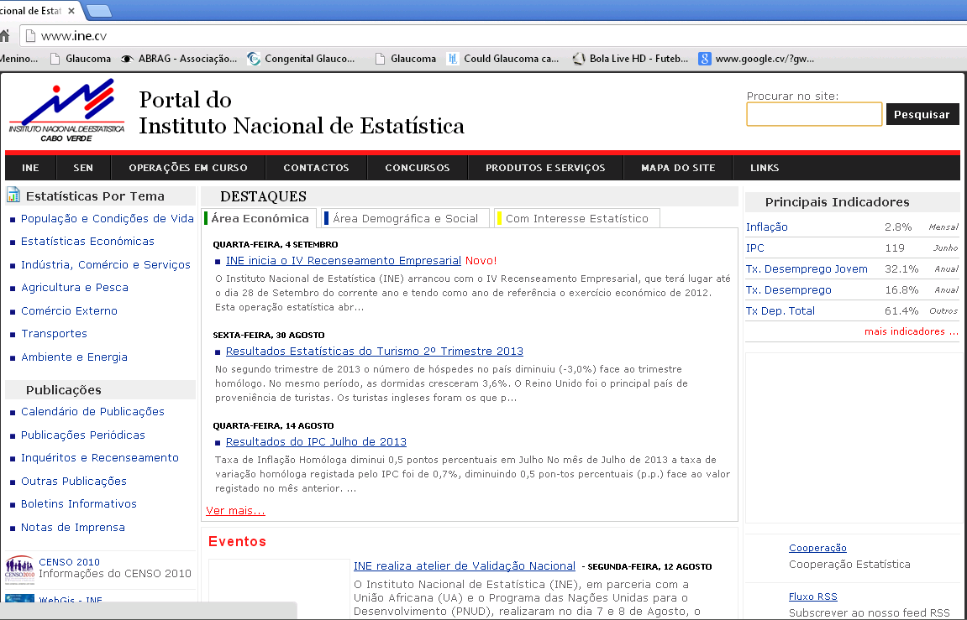
Data Dissemination in INE
www.ine.cv

Slide 14
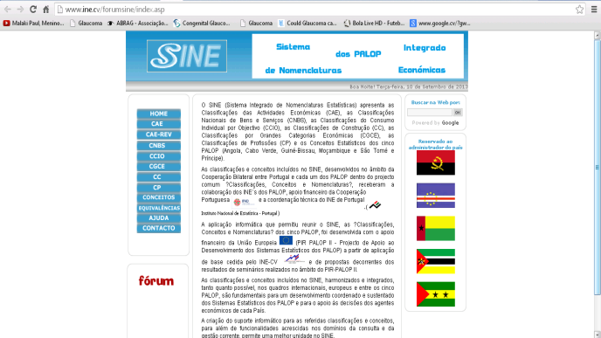
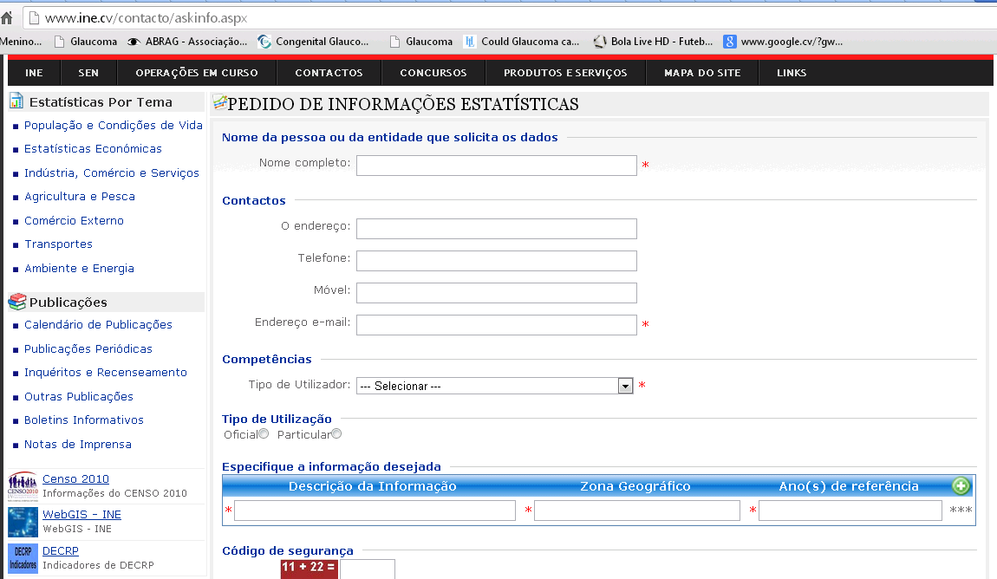
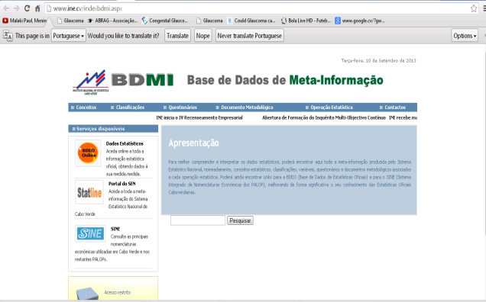
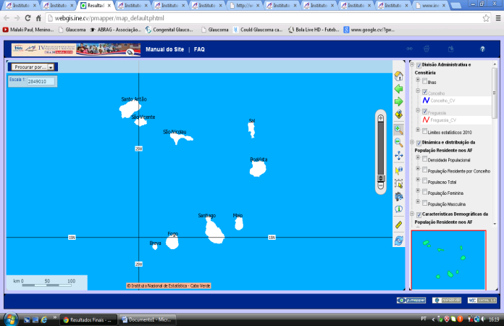
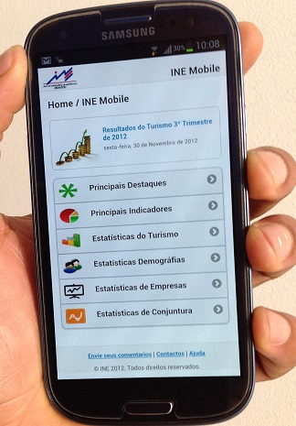
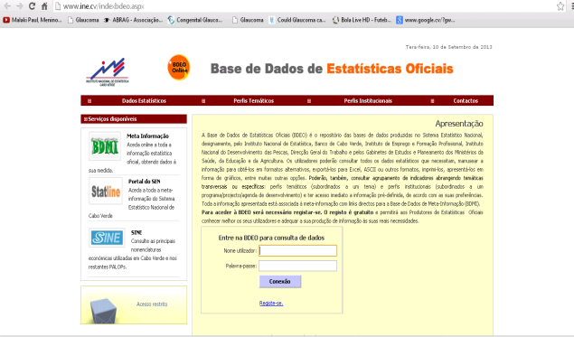
Data Dissemination in INE
Cape Verde Census Info
SINE (CPLP)
BDEO
BDMI
Data Request
INE Mobile
WebGIS-INE

Slide 15
The WebGIS-INE - Background
In 2010 the NIS, conducted a Population and Housing Census
Use of New Technologies (Mobile Devices)
Use of GIS to support data collection and dissemination
Completely Digital Census (One of the first in Africa)

Slide 16
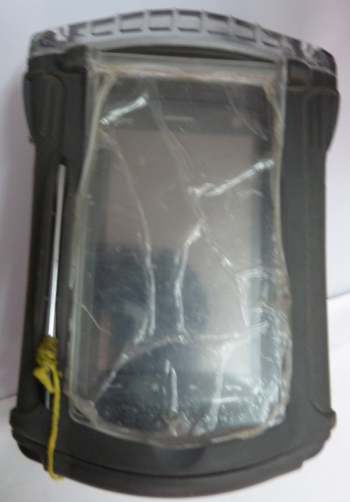
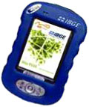
The WebGIS-INE - Background
Minimum use of paper
Geo referencing all household (Using GIS and GPS)
Improve quality control
PDA (Personal Digital Assistant) with GPS (Global Positioning System).

Slide 17
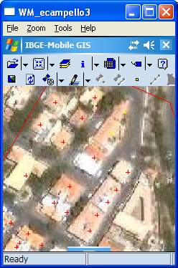
The WebGIS-INE - Background
Mobile GIS” – IBGE Mobile GIS
Technical and logistic support of the Brazilian Institute of Geography and Statistics (IBGE)
App that allows the visualizations, navigation map and use of GPS.

Slide 18
The WebGIS-INE - Background

Slide 19
The WebGIS-INE - Background
Geo Code
Edifice
Lodgment
Household
Individual

Slide 20
The WebGIS-INE – Geospatial Tool to Disseminate data through Internet
SIG INE-CV
Developed in P Mapper (Html)
Features - Shape files:
Interaction with the map (Zoom, Select the information that you want to view)
Help reading data
Query the data (spatial or numeric criteria)
“Create” maps (User design)
Export data, (Excel, CSV, and maps)

Slide 21
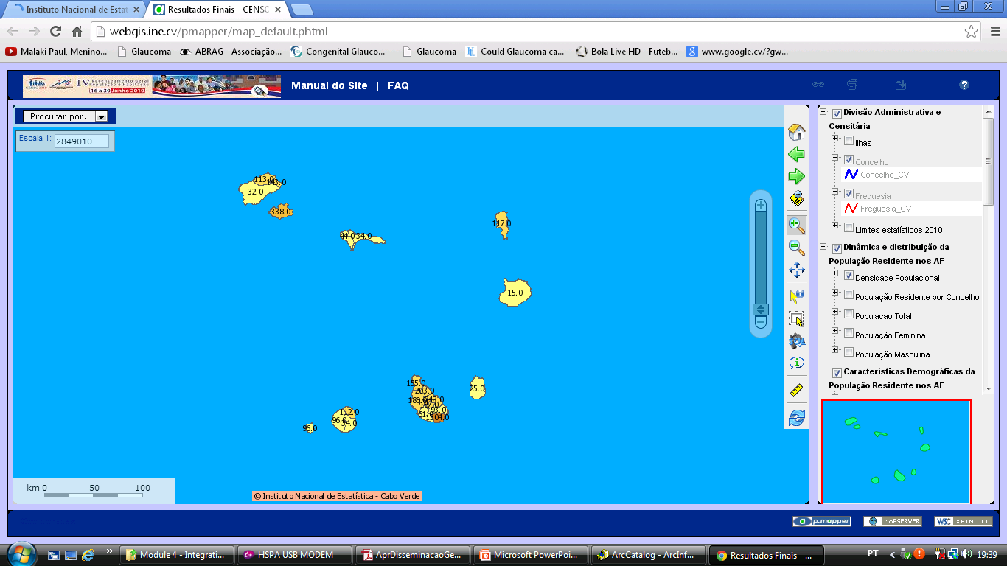
The WebGIS-INE – Geospatial Tool to Disseminate data through Internet
http://webgis.ine.cv
WebGIS INE

Slide 22
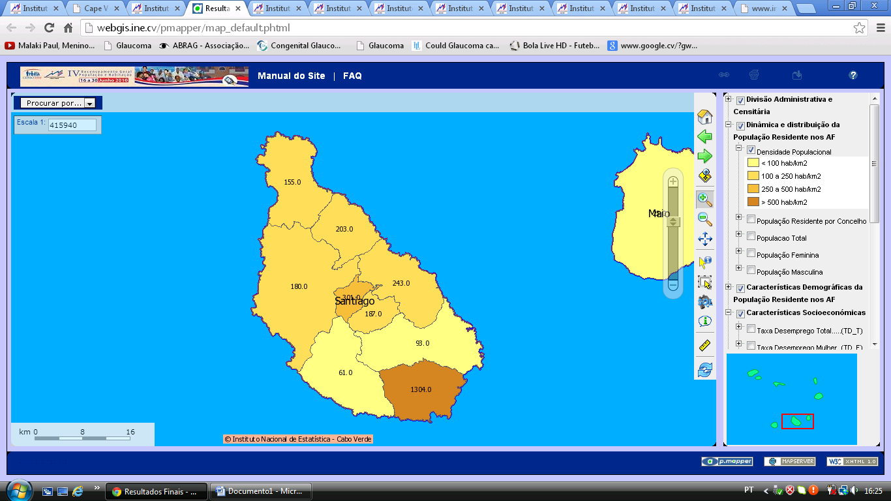
The WebGIS-INE – Geospatial Tool to Disseminate data through Internet
Navigate the map, Select, Enable, Disable the layer/information

Slide 23
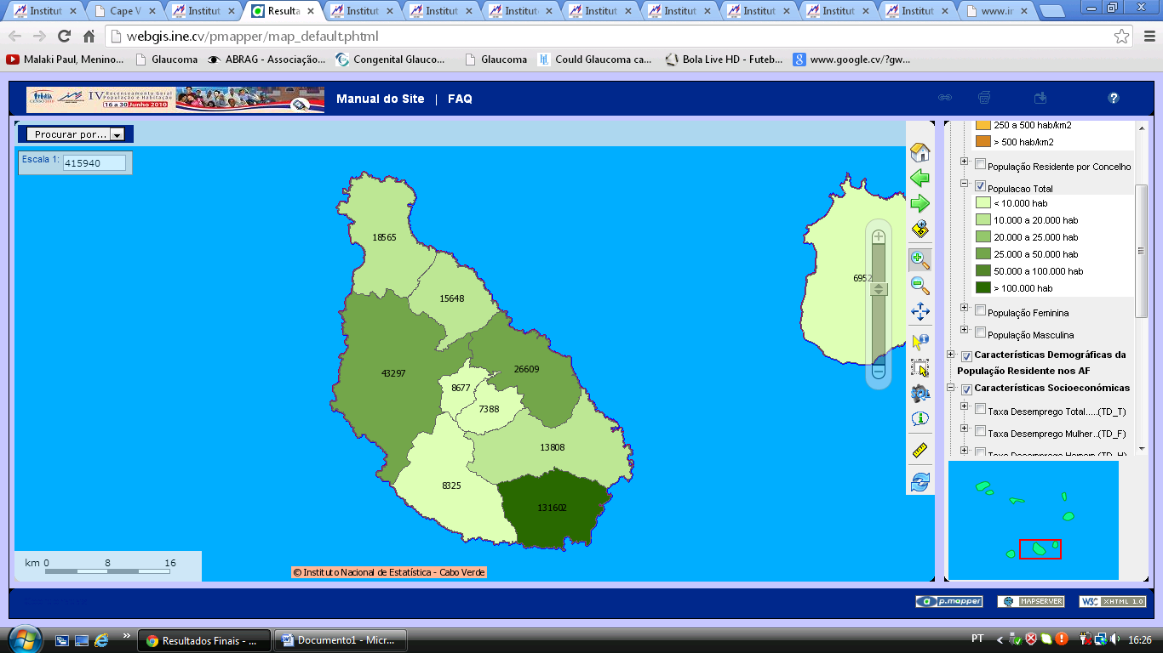
The WebGIS-INE – Geospatial Tool to Disseminate data through Internet
Navigate the map - Change the information

Slide 24
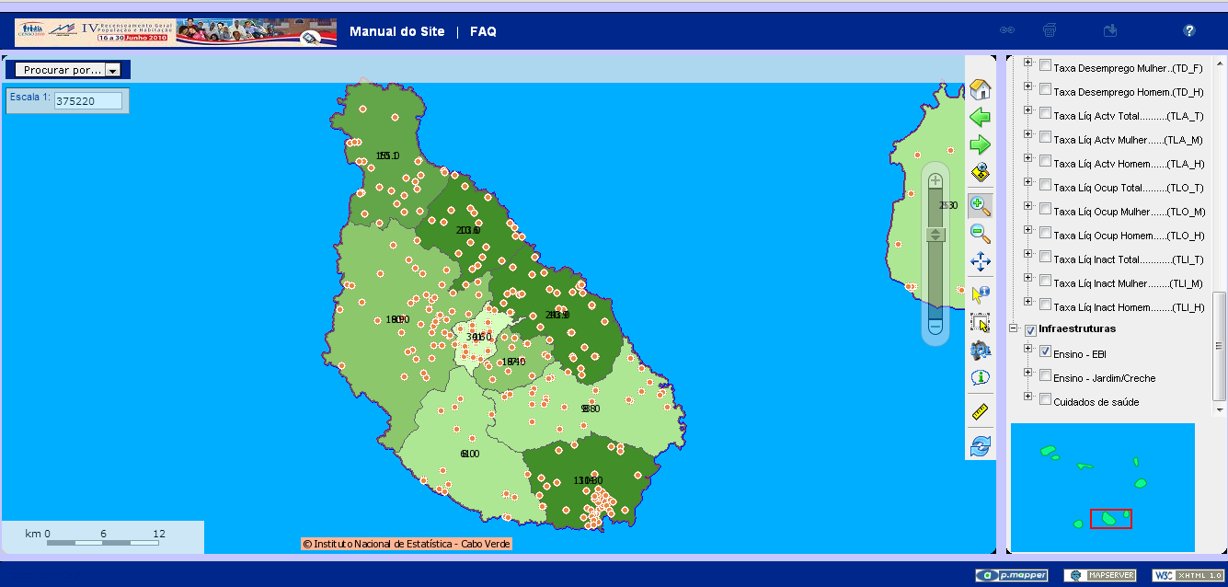
The WebGIS-INE – Geospatial Tool to Disseminate data through Internet
Overlap some layers

Slide 25
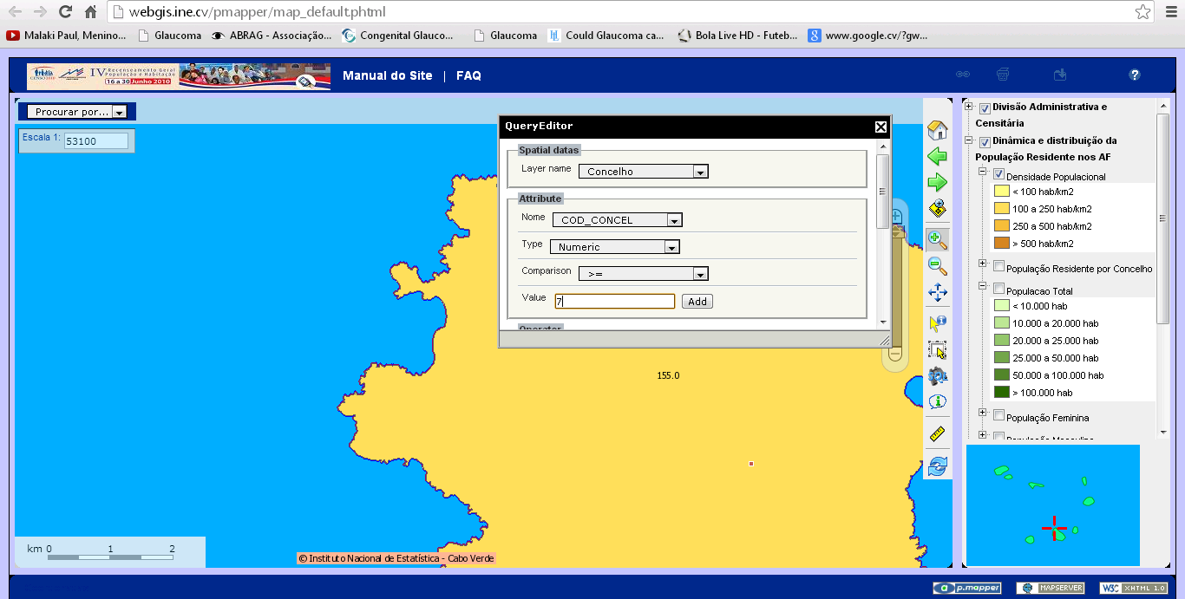
The WebGIS-INE – Geospatial Tool to Disseminate data through Internet
Query the data (SQL)

Slide 26
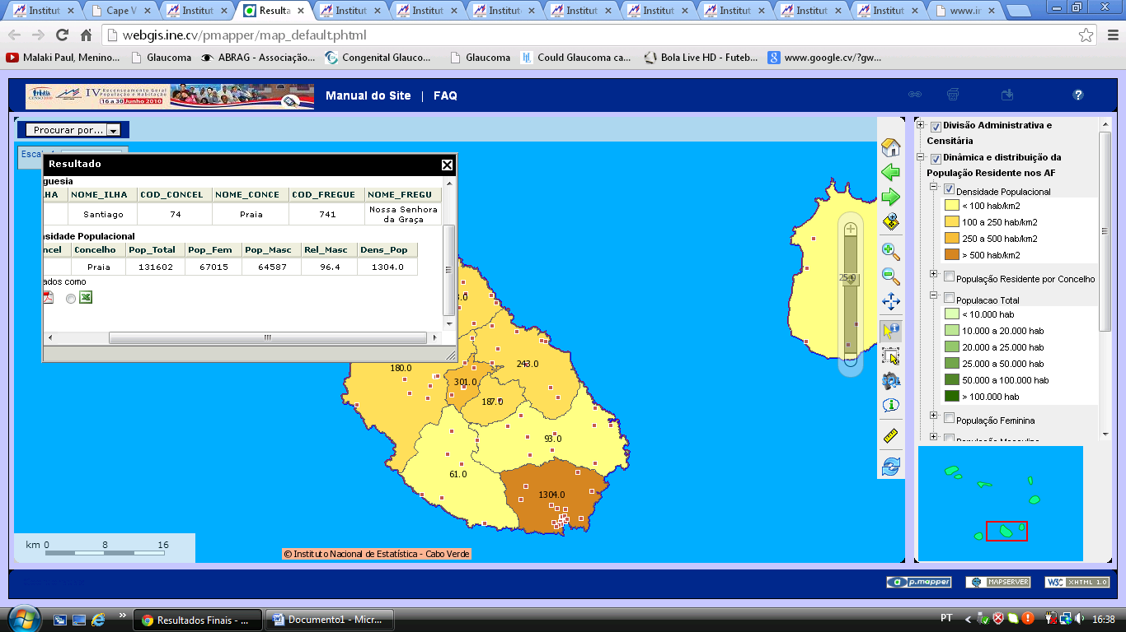
The WebGIS-INE – Geospatial Tool to Disseminate data through Internet
Export data (CSV, Excel, PDF) and export maps

Slide 27
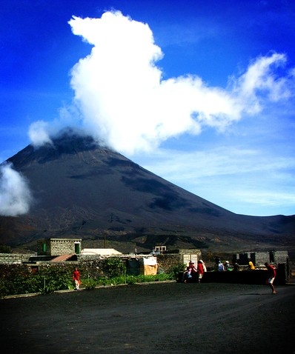
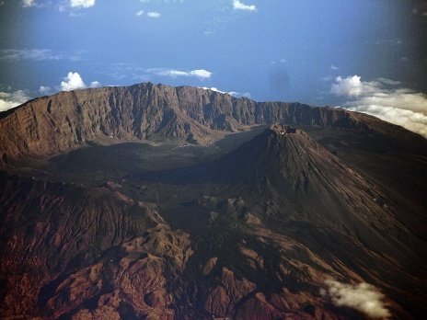
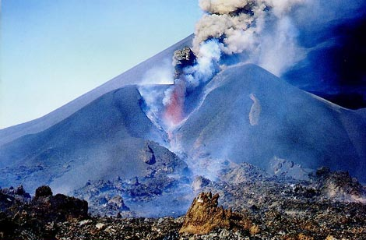
An Example of integrating Statistical and Spatial Data
Highest point of Cape Verde: 2829 m
Fogo
www.wikipedia.pt
www.caboindex.com
http://hotelxaguate.com
www.topicos123.com

Slide 28
An Example of integrating Statistical and Spatial Data
Hill shed Model of Fogo
A simulation for the development of an emergency plan and risk map (volcanic outburst) using Census data

Slide 29
An Example of integrating Statistical and Spatial Data
Using Different layers
Points, representing Households - number of individuals, age and sex
Circular areas from the peak (area of incidence)

Slide 30
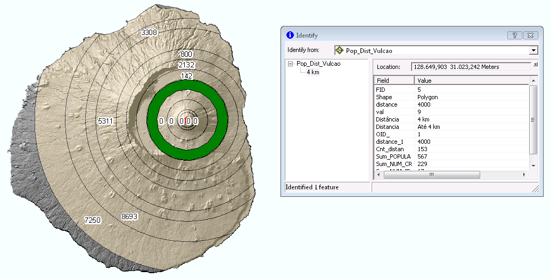
An Example of integrating Statistical and Spatial Data

Slide 31
Challenges
Improve the access to geospatial information
Improve visualization, and interactivity (more visual and more social)
Improvements in managing (Tools, data, Live ware)
Better use and integration of spatial and statistical data (Geostatitical Analysis)
Implementation of an harmonized and systematic Metadata (Geospatial data)
Increased and better management of Statistical metadata

Slide 32
Thank You for your attention
Obrigado
Amândio Furtado
Dissemination Team INE CV amandio.furtado@ine.gov.cv

